Slide 1
Talat Mokhtari.Azad
Director of National Influenza Center
School of Public Health
Tehran University of Medical Sciences
Novel-corono virus characteristics and laboratory diagnosis

Slide 2
Intoduction
Despite remarkable advances in medical science and treatment during 20th century, infectious diseases remain the leading cause of death worldwide
Emerging disease is a disease that has never been recognized before.
.During the last 20 years, at least 30 new infectious have emerged.
These diseases are the leading cause of death worldwide, claiming at least 17 million lives every year.

Slide 3
Coronaviridae structure and classification
Why do we have new viruses in this family
Sensitivity to chemical material
Laboratory diagnosis
Control and prevention

Slide 4
Deduction
SARS
H5N1
H1N1
MERS
Ebola
Zika
N-Cov
2000
2005
2010
2015
2020

Slide 5
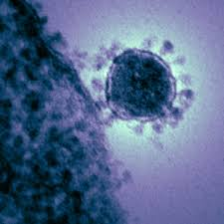
Coronaviridae
Coronaviridae is a family of:
enveloped, positive-sense, single-stranded RNA viruses.
The viral genome is 26–32 kilobases in length.
Coronaviruses (CoVs) are characterized by club-shaped spike projections emanating from their surface of the virion, which in electron micrographs of spherical particles create an image reminiscent of the solar corona.
The structure of CoVs comprises the spike (S), envelope (E), membrane (M), and nucleocapsid (N). The family Coronaviridae is organized in 2 sub-families, 5 genera, 23 sub-genera and about 40 species

Slide 6
Family: coronaviridae Subfamily: coronavirinae Genus: alpha, beta, gamma and delta coronaviruses
The Alphacoronoviruses: NL-63, 229E
The Beta-CoVs of the greatest clinical importance concerning humans are:
A lineage: OC43 and HKU1
B lineage: SARS-CoV and 2019-nCov
C lineage:MERS-CoV
The Alphacoronavirus and Betacoronavirus genera descend from the bat gene pool.

Slide 8
Human infection with coronaviruses is common, but they usually cause nothing more than a cold. A range of animals are also susceptible to coronaviruses, but these viruses do not tend to transmit to humans.
However, in some cases, an animal coronavirus can jump from animal to human. For instance, the viruses that caused the severe acute respiratory syndrome (SARS) outbreak in 2003 and the Middle East respiratory syndrome (MERS) outbreak in 2012.

Slide 9
Full genome tree of all Coronavidae families
Red … BetaCoV 2019-2020
Blue … SARS CoV
Purple … MERS CoV
Green … common cold CoV
Phylogenetic tree shows virus is not close to common cold coronaviruses and only distantly
related to SARS-CoV;
• The available sequence also informs
diagnostics efforts.

Slide 10
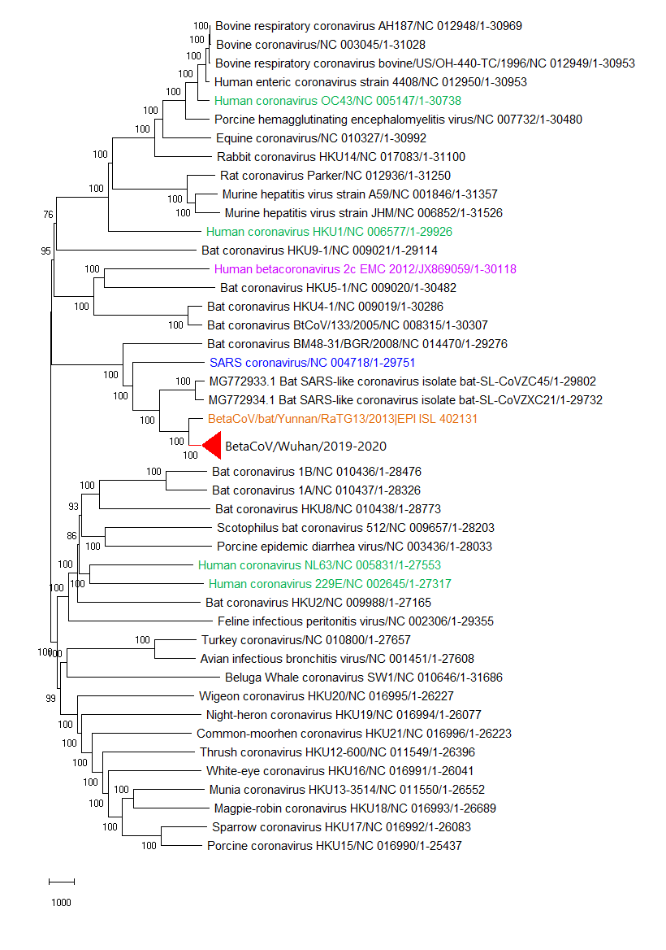
Orange … bat RaTG13
Red … BetaCoV 2019-2020
Blue … SARS CoV
Purple … MERS CoV
Green … common cold CoV
BetaCoV 2019-2020
Genome identity to BetaCoV:
96% RaTG13 (nearest bat precursor)
88% ZC45/ZXC21 bat precursor
80% SARS

Slide 11
Genome identity to BetaCoV:
96% New nearest bat precursor
88% Previous nearest bat precursor
80% SARS

Slide 12
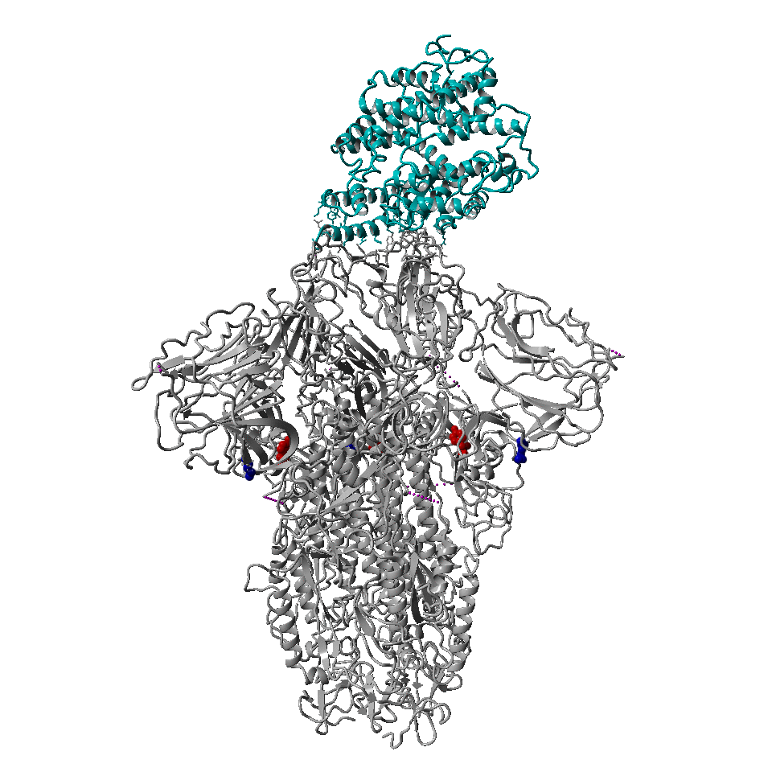
Receptor binding surveillance for current sequences
Cyan … ACE2 human host receptor
Gray … CoV spike glycoprotein
Surface proteins are 76% and 98% identical, respectively
Antigenic surface highly divergent compared to SARS
Bat precurser differences in receptor binding interface indicative of changes that allowed host switch
Spike glycoprotein variation so far:
H58Y
Guangdong/20SF028/2020|EPI_ISL_403936|2020-01-17
Guangdong/20SF040/2020|EPI_ISL_403937|2020-01-18
F41I
Wuhan/HBCDC-HB-01/2019|EPI_ISL_402132|2019-12-30
No mutation near the binding interface so far
We gratefully acknowledge the Authors from Originating and Submitting laboratories of sequence data on which the analysis is based.
by BII, A*STAR Singapore

Slide 13
Why do we have new viruses in this family
Coronaviruses are zoonotic, meaning they are transmitted between animals and people.Several known coronaviruses are circulating in animals that have not yet infected humans.
An unusually large RNA genome 26-32 kb , and In comparing with the genomes of all other RNA viruses have the largest genome. coronavirus genomes contain cis-acting RNA elements that ensure the specific replication of viral RNA
Like other RNA viruses has the potential for mutation.

Slide 14
Specimen Collection
Throat swabs is routine specimen but some times we receive endotracheal aspirates or bronchoalveolar lavages or necrospy.
Use only sterile dacron, rayon or polyester fibre swab.
We know that cotton swabs, or swabs with wooden stick should not be used because they may contain substances that inactivate some viruses and inhibit PCR testing but some time if they have not access to the dacron swab may use cotton swab.

Slide 15
Viral Transport Media
NIC prepare VTM for country
Patient specimen with ID

Slide 16
Samples to be collected (see Table 1 for details on sample collection and storage
Respiratory material:
nasopharyngeal and oropharyngeal (dacron or polyester swabs in VTM).
endotracheal aspirate or bronchoalveolar lavage in patients with more severe respiratory disease (sterile container with VTM)
Sputum – Sterile container

Slide 17
Information to be recorded:
name, date of birth, sex and residential address, unique identification number, other useful information (e.g. patient hospital number, surveillance identification number, name of hospital, hospital address, room number, physicians’ name and contact information, name and address for report recipient),
Date and time of sample collection,
Anatomical site and location of specimen collection,
Tests requested,
Clinical symptoms and relevant patient history (including vaccination and antimicrobial therapies received, epidemiological information, risk factors).

Slide 18
Laboratory Diagnosis
Laboratories may desire to use a pan-coronavirus assay for amplification followed by sequencing of amplicons from non-conserved regions for characterization and confirmation.
The importance of the need for confirmation of results of testing with pan-coronavirus primers is underscored by the fact that four human coronaviruses (HcoVs) are endemic globally: HCoV-229E, HCoV-NL63, HCoV-HKU1 as well as HCoV-OC43.
Alternatively, amplification and detection of 2019-nCoV specific sequences can be diagnostic without the necessity for further sequencing.

Slide 19
Full genome of Coronaviridae

Slide 20
Coronaviridae genes for diagnosis
First line screening assay: E gene assay
Confirmatory assay: RdRp gene assay

Slide 21
Diagnostic knowledge gaps
Molecular testing
What are the best clinical specimens for optimum RT-PCR yield and identification of cases?
What is the excretion pattern of the virus and when is the best time for sampling?
How long after recovery do individuals shed the virus, and from which anatomical sites?
What is the range of genetic diversity among 2019-nCoV isolates? Will this diversity affect test performance (nucleotide changes in the primer/probe binding region)?

Slide 22
Both influenza A and B viruses survived for 24-48 hours on hard, nonporous surfaces such as stainless steel and plastic
Survived for <8-12 hr on cloth, paper, and tissues.
Virus survived on hands for up to 5 min after transfer from the environmental surfaces.
Transmission of virus from donors who are shedding large amounts could occur for 2-8 hr via stainless steel surfaces and for a few minutes via paper tissues
SARS-Co V was completely inactivated by heating at 56°C for 60 min or longer.
The combination of spraying and wiping the bench with 70% ethanol, followed by UV irradiation may completely inactivate any virus on the bench.
Environmental cleaning: 1:10 bleach solution

Slide 23
how to wear a medical mask properly, following WHO guidelines.
Use medical masks only once, then throw them in a safe, covered trash can.
Wearing a mask must cover both the nose and mouth.
When wearing a mask, do not touch your hands to avoid hands being infected with viruses and other pathogens, then spread the disease to yourself and others.
When removing the mask, only hold the strap by the ear, not the mask, then put it in the safe trash.
Immediately after discarding the mask, wash your hands with soap and clean water.

Slide 24
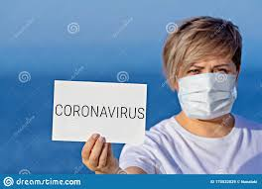
For the general public, no additional precautions are recommended at this time beyond the simple daily precautions that everyone should always take.
It is currently flu and respiratory disease season, and flu activity is still high and expected to continue for a number of weeks.
Standard recommendations to prevent infection spread include regular hand washing, covering mouth and nose when coughing and sneezing, thoroughly cooking meat and eggs.
Avoid close contact with anyone showing symptoms of respiratory illness such as coughing and sneezing.

